Slide 1
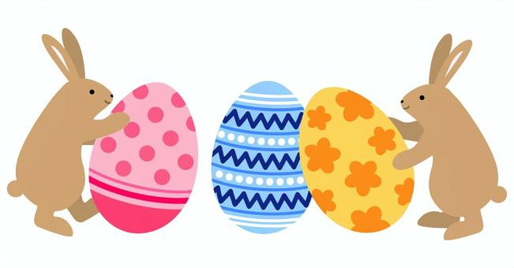
Valley Township Annual Easter Egg Hunt
Friday, March 29, 2024 at 3:00 pm
(rain date Saturday, March 30 at 12 noon)
Rainbow Elementary School
1113 West Lincoln Highway
Coatesville, PA 19320
Valley Township children
Ages 2 – 10
**Please feel free to bring your own camera if you would like a photo with the Easter Bunny**

